Slide 1


Digital Humans
Lesson 3 + 4: AI models vs Machine Learning Algorithms 04 OKTOBER 2022
Making sense of AI
Computational Foundations of
Machine Learning [ML] &
Deep Learning [DL]
Prometheus Data-Lab (Wijnhaven 103)
Rob van der Willigen
Tech-Lead Programma AI & Ethics

Slide 2


CONTEXT
Prerequisites: basics in linear algebra, probability, and analysis of algorithms.
Workload: Do it your-self [DIY] assignments

Slide 3
Simple Predicting Machine
Elements of AI ?

Slide 4
Elements of [any] AI
Needs a [computational?] Learning Algorithm
Needs [unstructured / structured?] data
Needs [input?] sensors
Needs [output?] effectors
Needs [cybernetic?] modeling

Slide 5
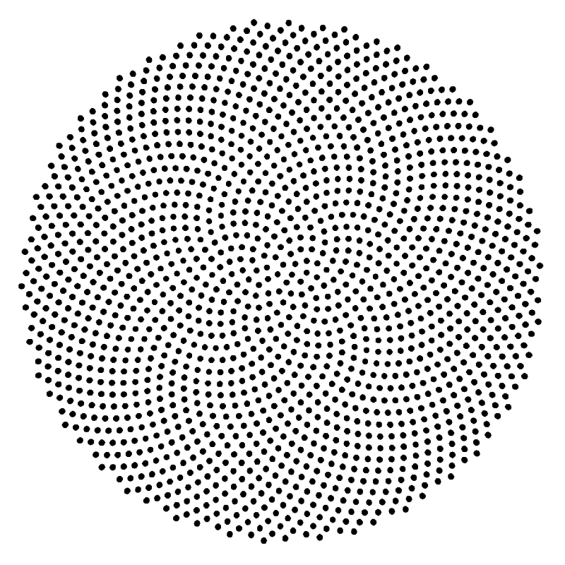
{01}
Fundamentals: [Cybernetic] Modeling

Slide 6
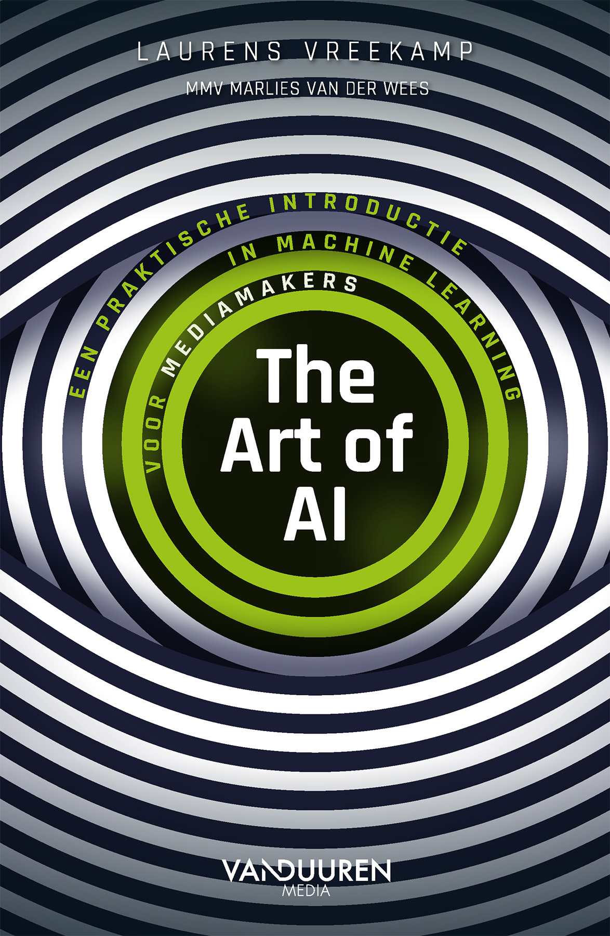
Modeling [Modellen / Modeleren]
is een hulpmiddel
is een vereenvoudiging van de werkelijkheid
helpt om de werkelijkheid te beschrijven en te begrijpen
is eenduidig
is niet per se normatief en/of voorschrijvend
is te vertalen naar en te begrijpen in de beoogde probleem context
(ML-)model: een computer programma;
Het gebruiksklare resultaat van het ML-leerproces (trainen)
“….Een model is een schematische, vaak versimplelde weergave van de werkelijkheid.” ………

Slide 7
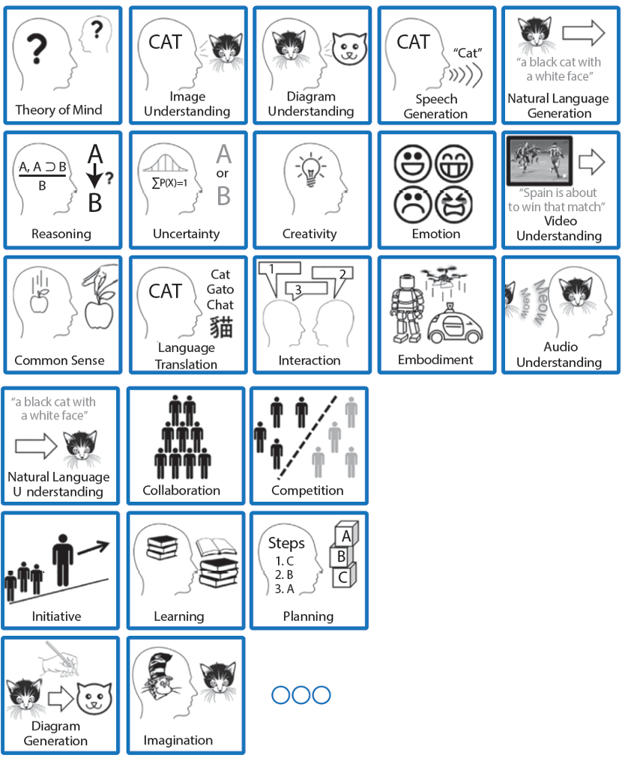
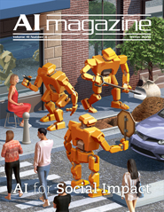
{01}
Fundamentals
AI aims to mimic & automatise tasks which otherwise require human perception, cognition and/or motor skills.

Slide 8
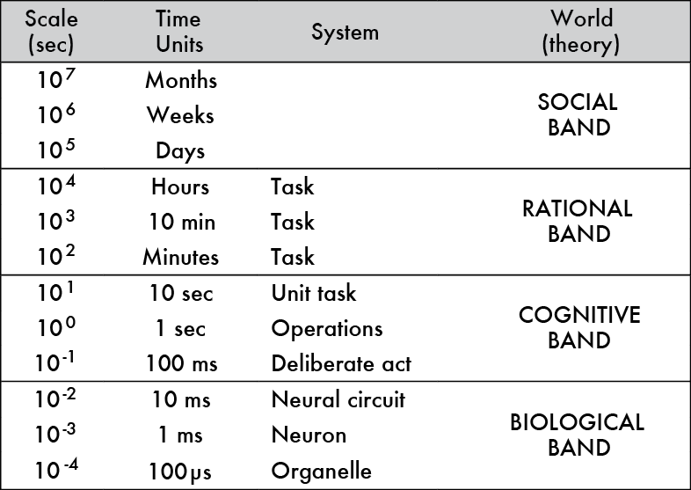
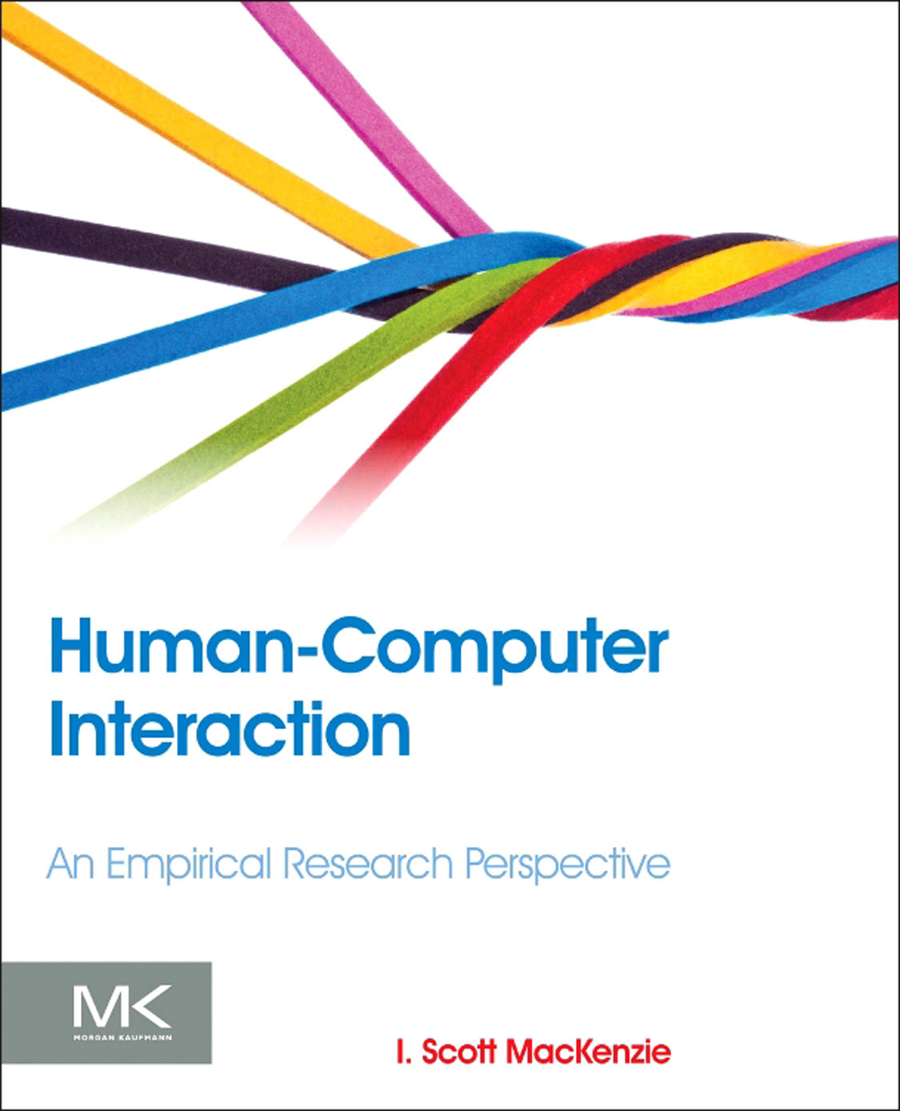
{01}
Fundamentals
AI is Modeled on
How Humans Proces Information
Sensation: [Sensibilisatie]
‘…immediate and basic experiences generated as stimuli fall on our sensory systems’
➔ Verwerken van ruwe data (prikkels of Fysieke stimuli) volgens een vast patroon
Perception: [Perceptie]
‘…interpretation of those sensations, giving them meaning and organization’
➔ Gestuurd door “ingebouwde” informatie (niet lerend),
Cognition: [Cognitie]
‘…acquisition, storage, retrieval, and use of information’
Gestuurd door “verworven” informatie (zelf-lerend)
M.W. Matlin & H.J. Foley, 1992

Slide 9
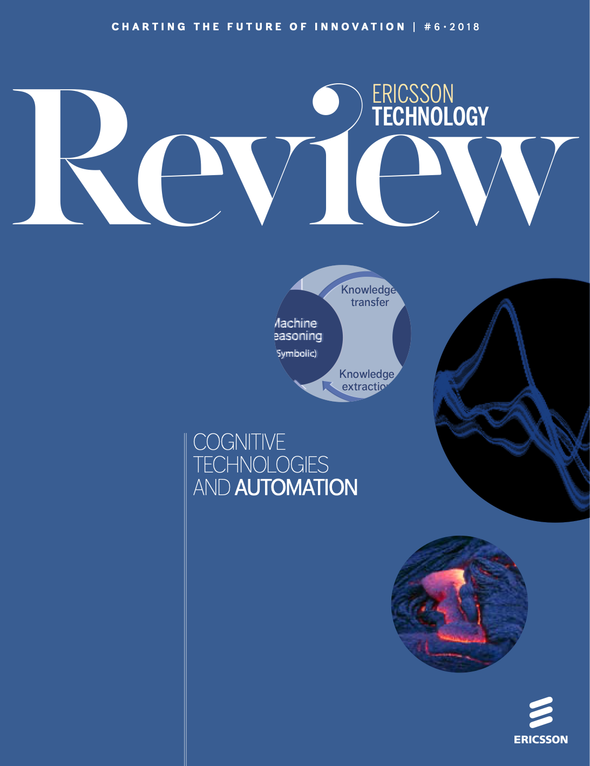
{01}
Fundamentals
AI is modeled on how humans proces information
Knowing
Known facts
Previous experience
Sensing
Thinking
Acting
The model of mind

Slide 10
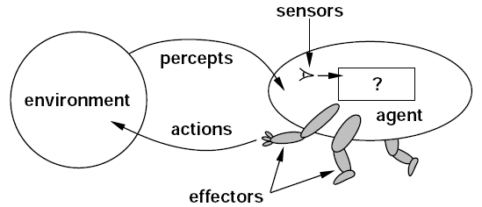
{01}
Fundamentals
AI is modeled through Agents
An agent
is anything that can perceive its environment through sensors and acts upon that environment through effectors.
10

Slide 11
{01}
Fundamentals
AI is modeled through Agents
Human agent has sensory organs such as eyes, ears, nose, tongue and skin parallel to the sensors, and other organs such as hands, legs, mouth, for effectors.
Robotic agent replaces cameras and infrared range finders for the sensors, and various motors and actuators for effectors.
Software agent has encoded bit strings as its programs and actions.
11

Slide 12
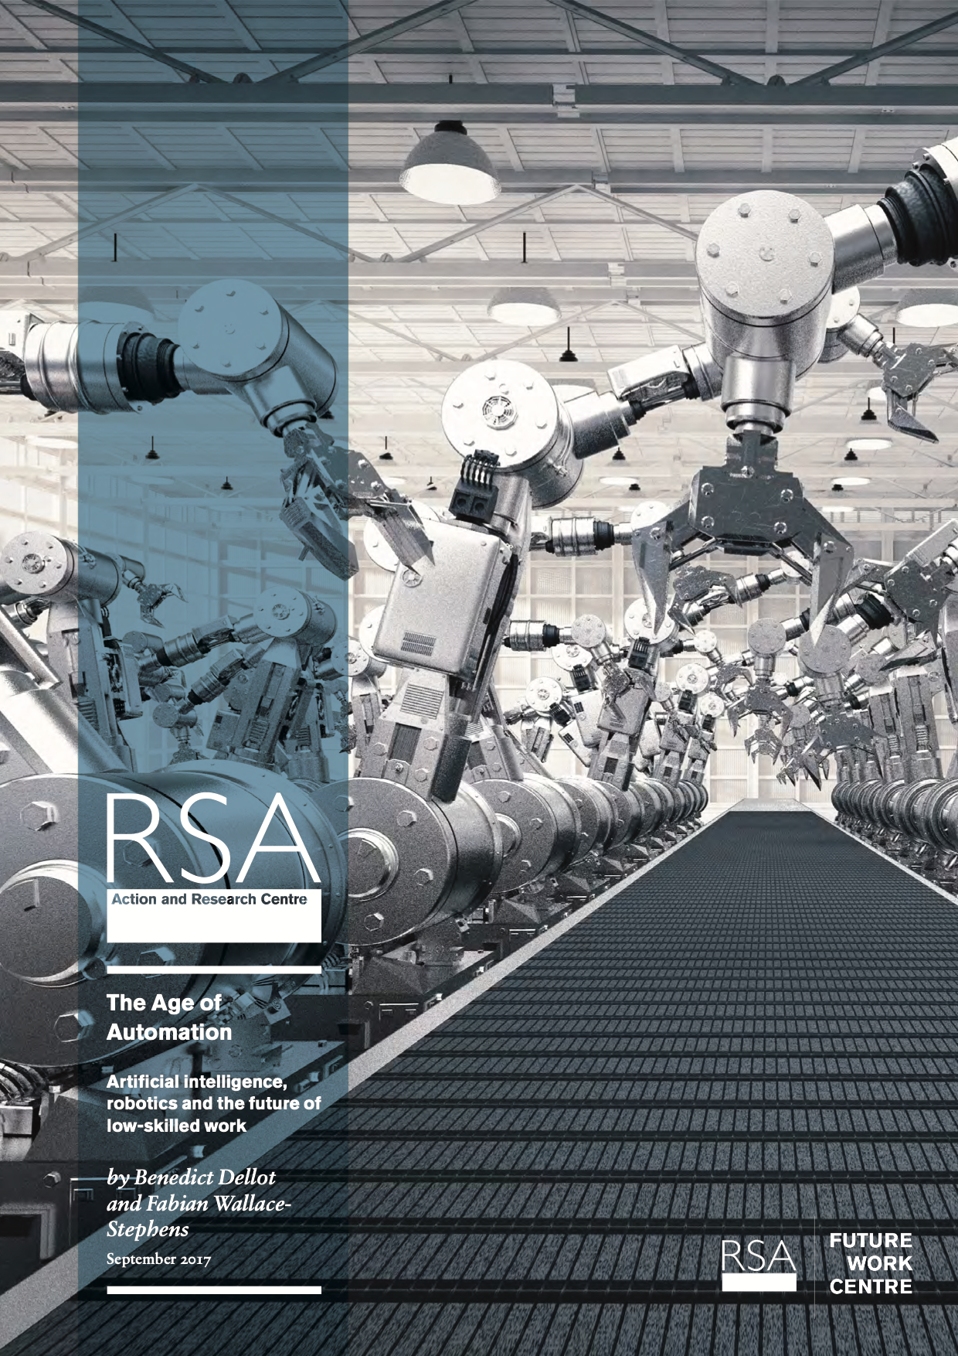
{01}
Fundamentals
AI is often defined
as software agent

Slide 13
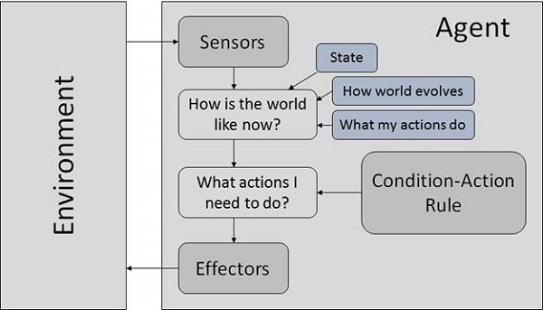

{01}
Fundamentals
Goal based Robotic Agents
need AI (human cognition)
13

Slide 14
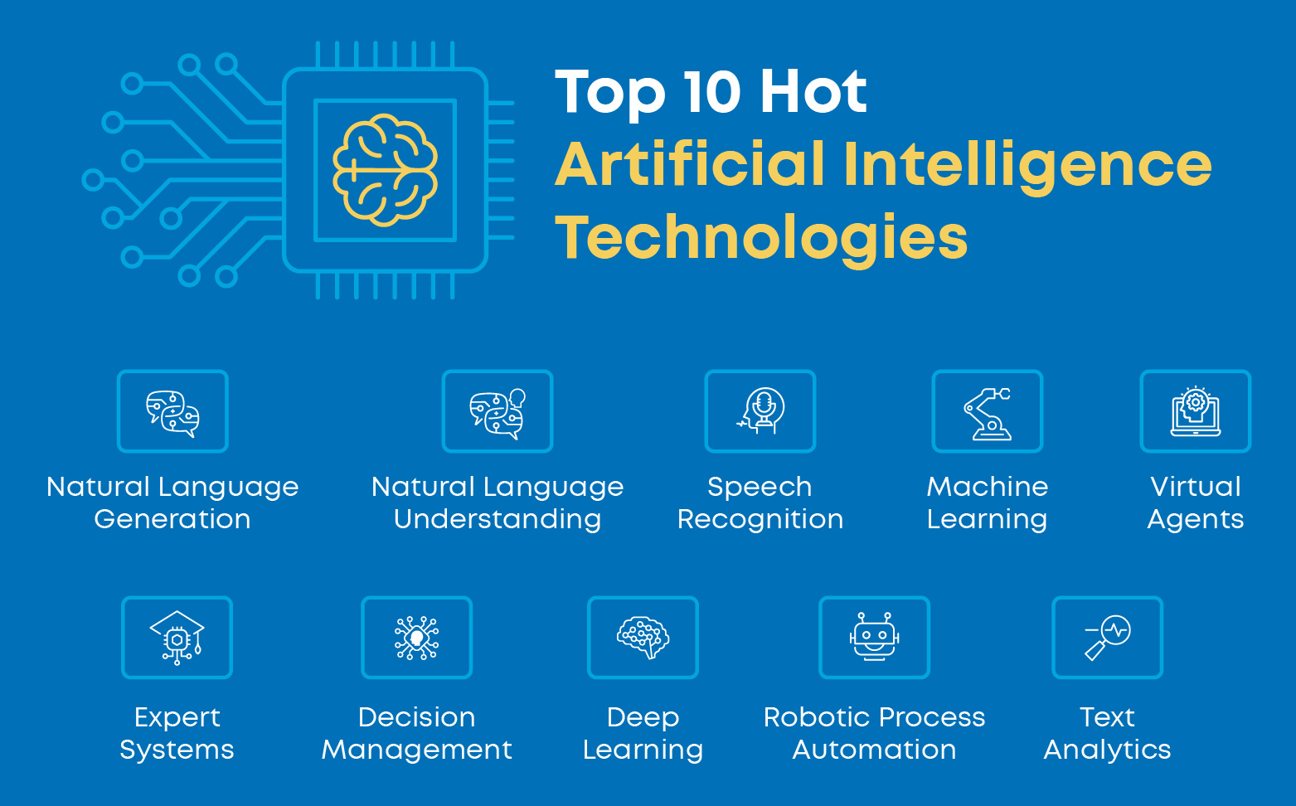
{01}
Fundamentals

Slide 15
{01}
Fundamentals

Slide 16
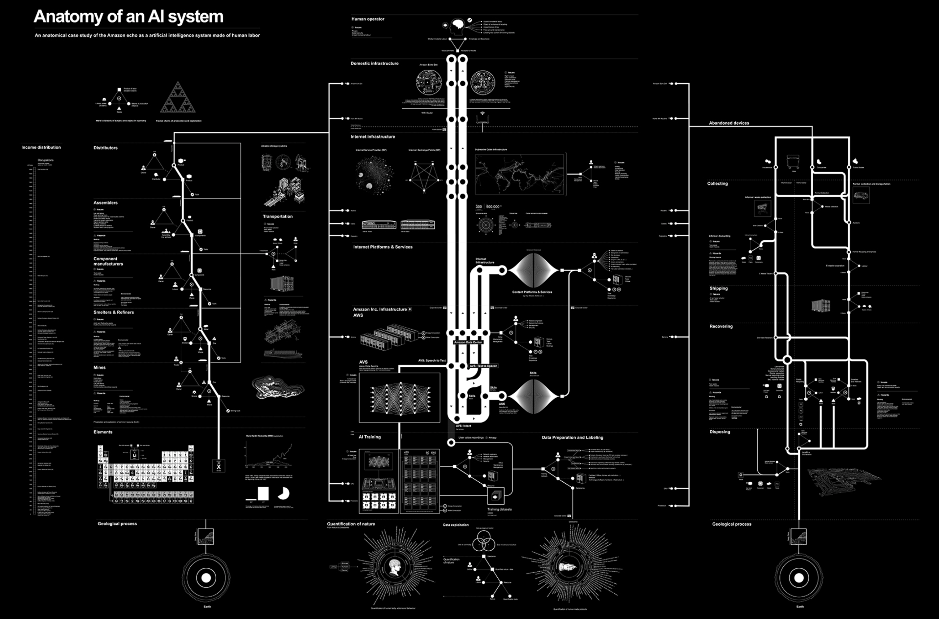
{01}
Fundamentals
http://www.anatomyof.ai/img/ai-anatomy-map.pdf

Slide 17
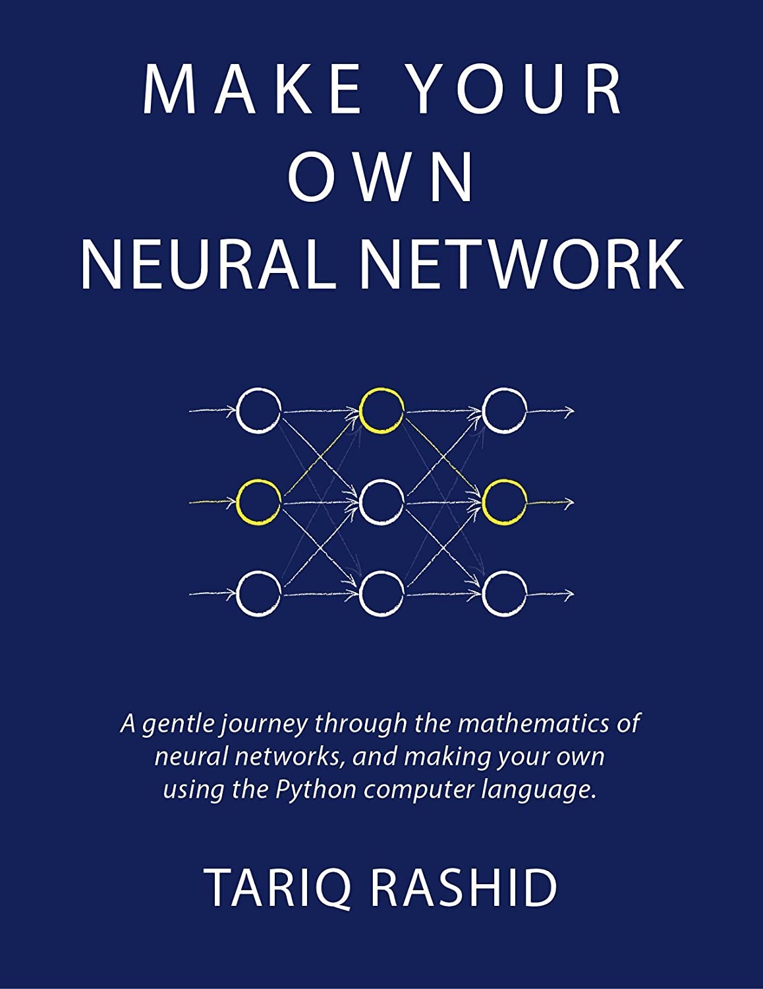
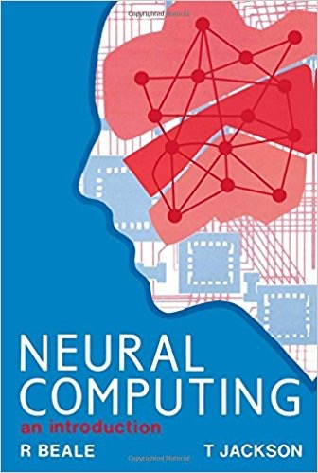
{02}
Fundamentals: Learning Algorithms

Slide 18


{01}
Fundamentals
https://machinelearningmastery.com/a-tour-of-machine-learning-algorithms/

Slide 19
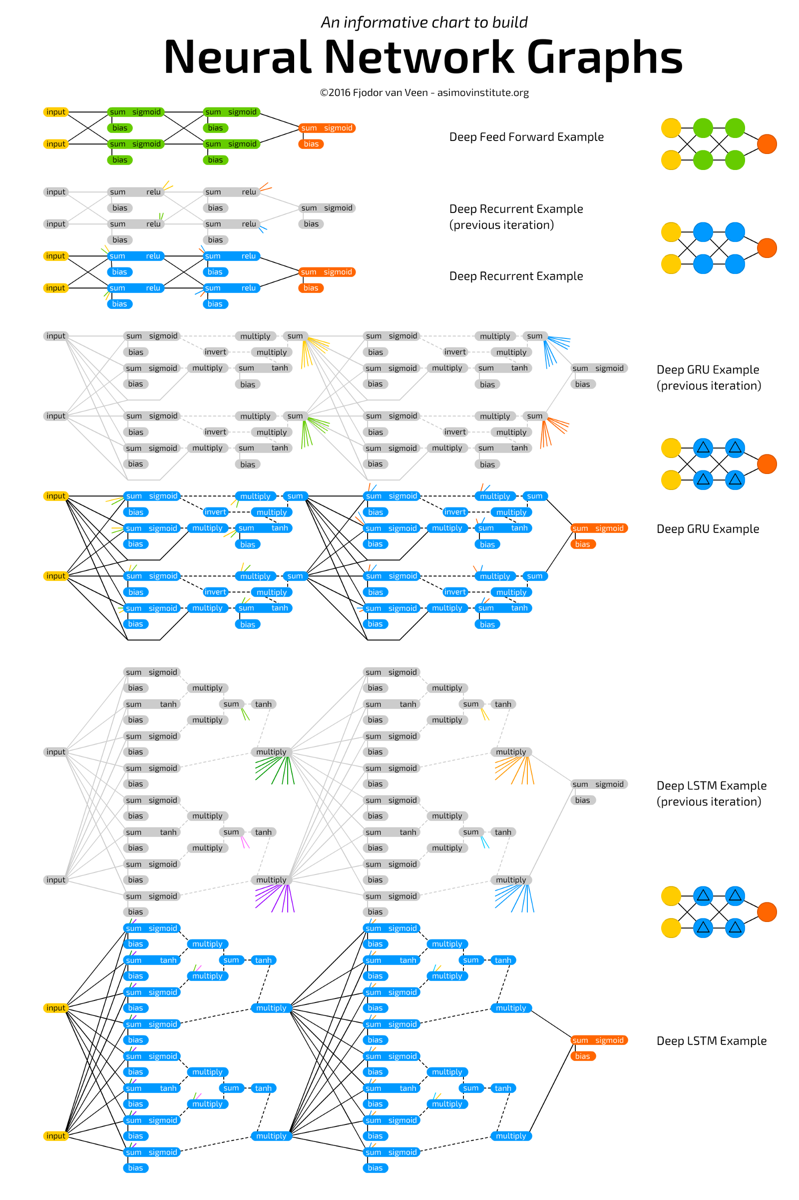

{01}
Fundamentals
https://www.asimovinstitute.org/neural-network-zoo/

Slide 20
Simple Predicting Machine
How do
Machines / Humans Learn?

Slide 21
LEARNING NEEDS?
Needs a [computational?] Learning Algorithm
Needs [unstructured / structured?] data
Needs [input?] sensors
Needs [output?] effectors
Needs [cybernetic?] modeling

Slide 22

Simple Predicting Machine

Slide 23
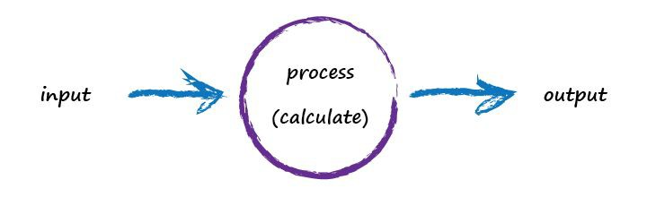
Simple Predicting Machine

Slide 24
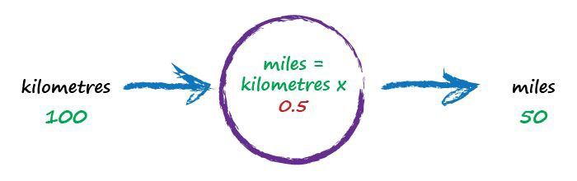
Kilometres to Miles
random starting parameter
try a model - this one is linear

Slide 25
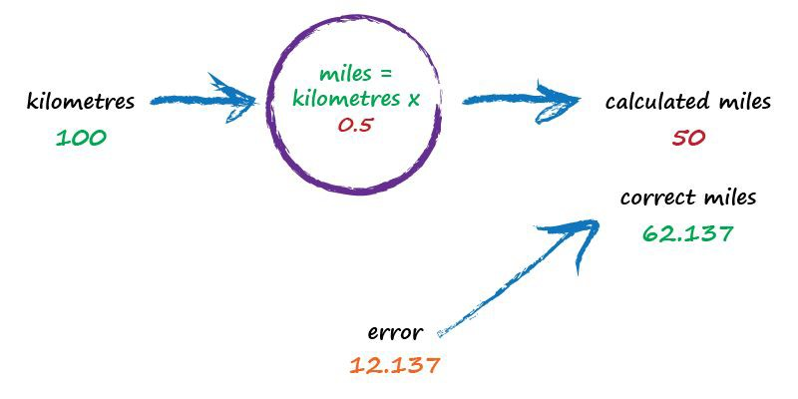
Kilometres to Miles
not great

Slide 26
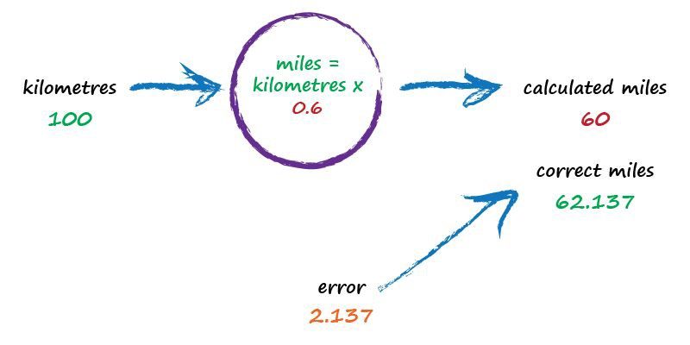
Kilometres to Miles
better

Slide 27
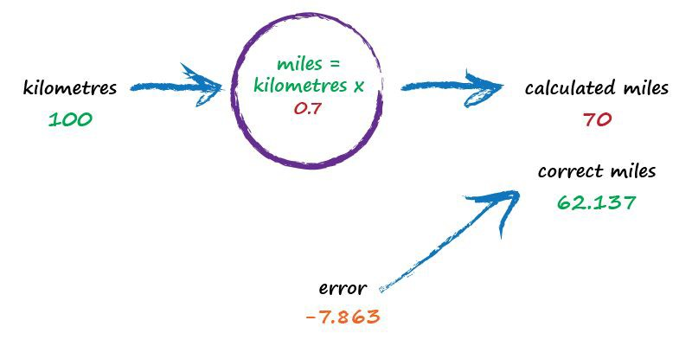
Kilometres to Miles
worse !

Slide 28
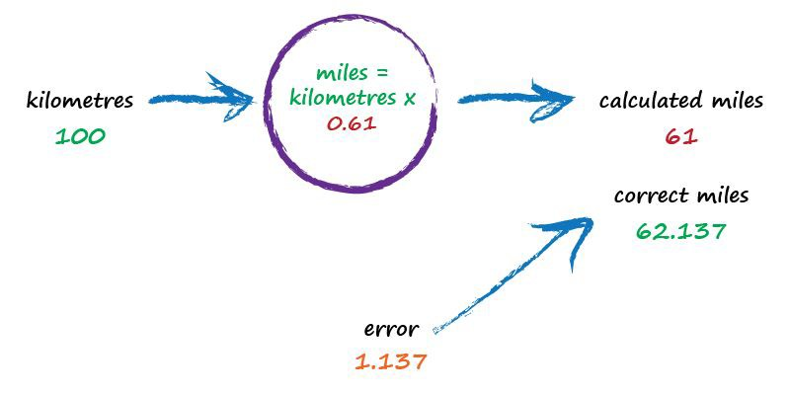
Kilometres to Miles
best yet !

Slide 29

Key Points
_{Don’t} know how something works exactly? Try a
1.
model with adjustable parameters.
_{Use} the error to refine the parameters.
2.

Slide 30
Basic Concept of Machine Learning (ML)
is iterative in nature;
requires a teacher & memory
best yet !

Slide 31
LEARNING in AI is defined as a computational algorithm
A tool for solving a well-defined (computational) problem by manipulating symbols
The word stems from the Persian mathematician al-Khwārizmī, who lived in the 9th century. His book describing the ‘Indian numbers’, which today we call Arabic numerals, introduced our modern decimal notation and its rules for arithmetic into Europe. The use of this system was called ‘algorism’ in the late middle ages and is transformed into today’s ‘algorithm’.
Crossley J.N., & Henry A.S. (1990)Thus spake al-Khwārizmī:
a translation of the text of Cambridge University Library Ms. Ii.vi.5 Hist. Math. 17(2) 103–31

Slide 32
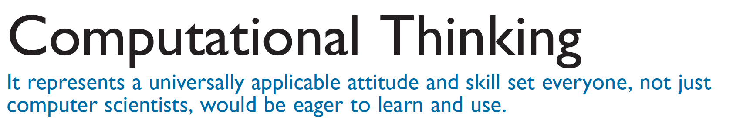
“ Computational thinking
is a way of solving problems,
designing systems, and
understanding human behavior
that draws on concepts
fundamental to computer science.”
COMMUNICATIONS OF THE ACM March 2006/Vol. 49, No. 3

Slide 34
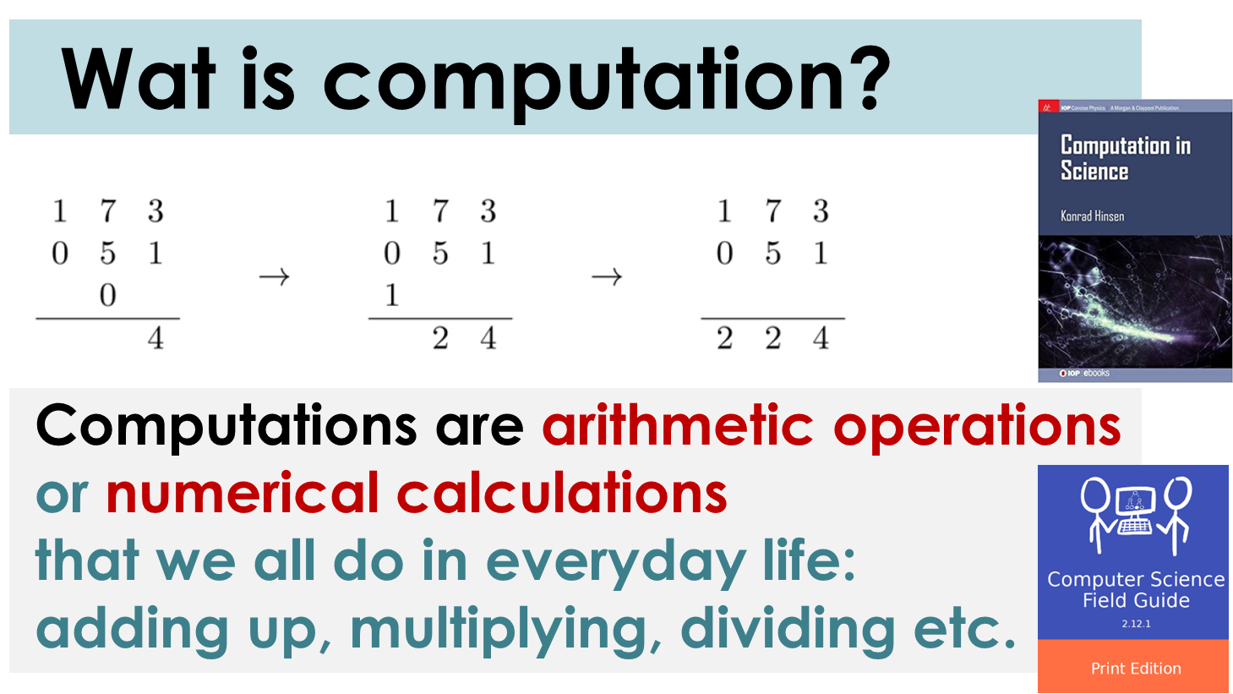

Slide 35
Wat is computation?
When thinking about computation,
it is important to recall that the
Universe of symbols & meanings are separate.
This is known as the distinction between
syntax and semantics.

Slide 36
NUMBERS vs SYMBOLS
Computations do not work on numbers alone,
but on a specific representation for numbers: Symbols.
Numbers are an abstract concept,
which cannot be manipulated using mechanical rules.

Slide 37
An algorithm is a
step by step process or recipe that describes how to solve a problem and/or complete a task, which will
always give the correct result

Slide 38
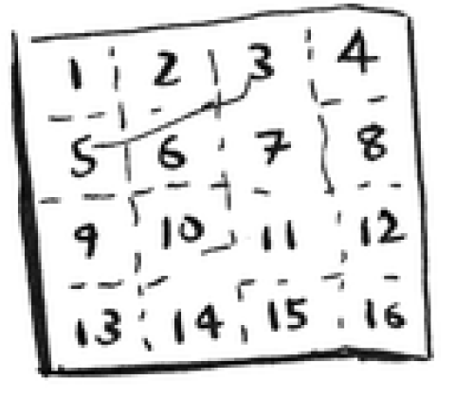
What’s a good algorithm to draw this grid?
38

Slide 39

Algorithm 1:
Drawing a grid one box at a time
One way to do it is to draw 16 boxes, one at a time.
How many operations will it take, drawing one box at a time?
39

Slide 40
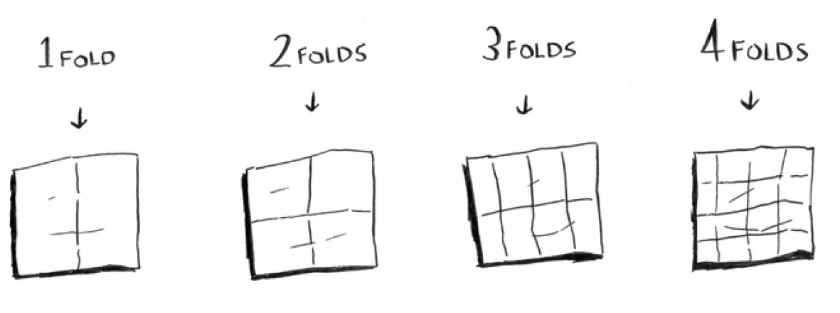
Algorithm 2:
Fold the paper again, and again, and again.
You can “draw” twice as many boxes with every fold,
so you can draw 16 boxes in 4 steps.
40

Slide 41
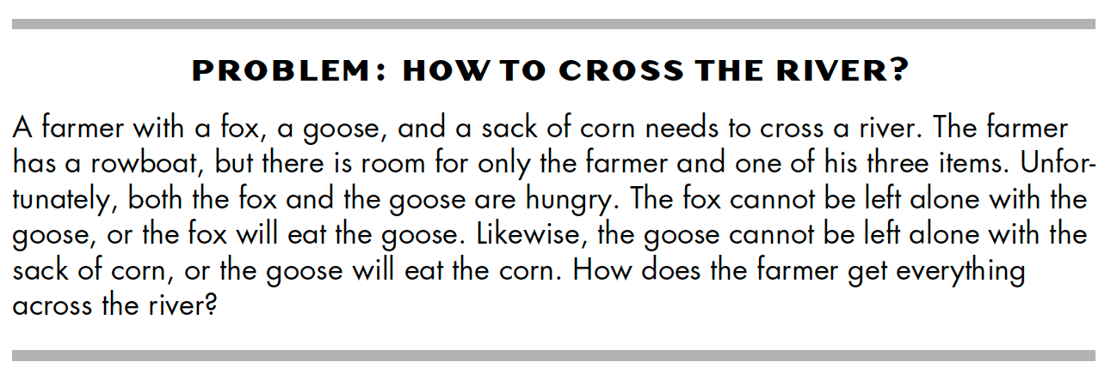
Algorithm 3:
The Fox, the Goose, and the Corn
41

Slide 42
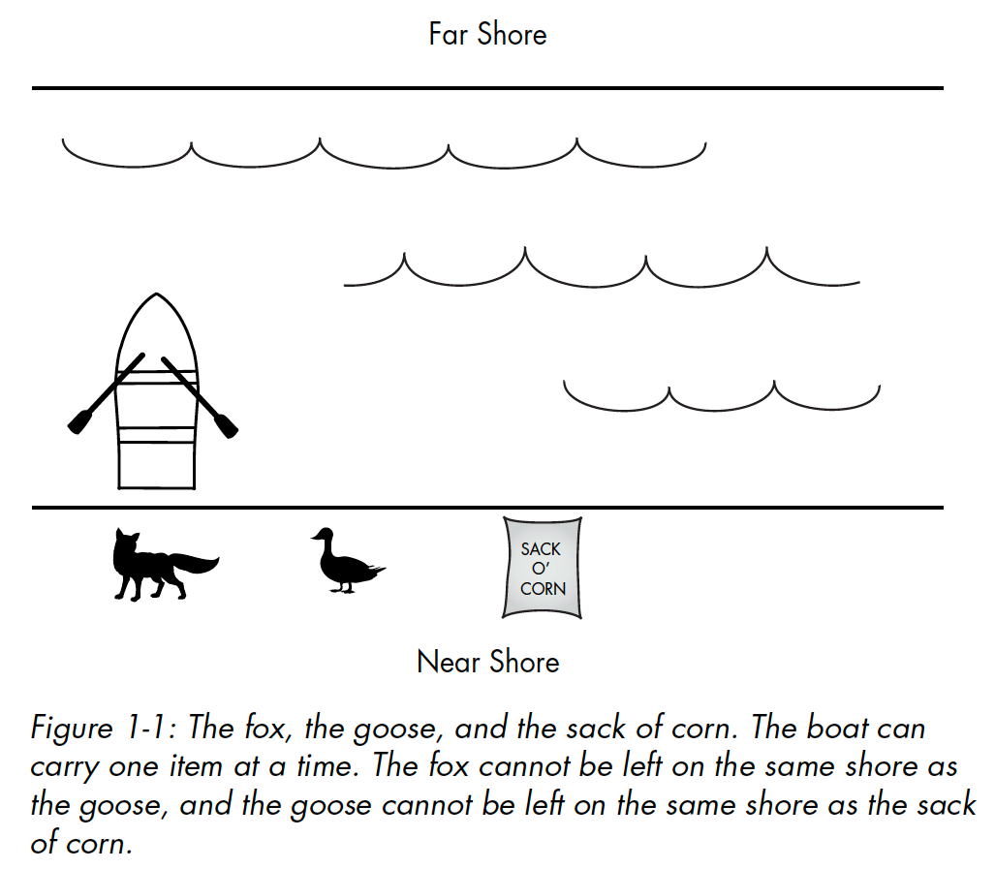
42

Slide 43
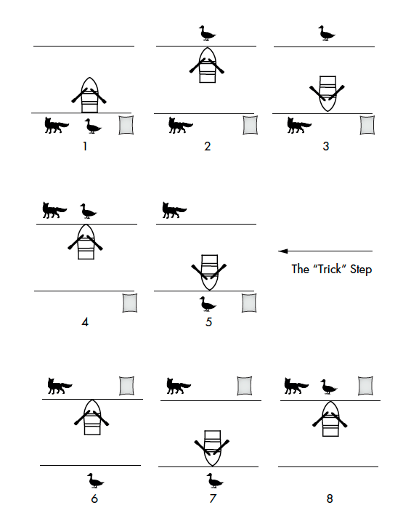
Algorithm 3:
Step-by-step solution to the fox, goose, and corn problem
43

Slide 44
{03}
Fundamentals: PERCEPTRON Algorithm

Slide 45
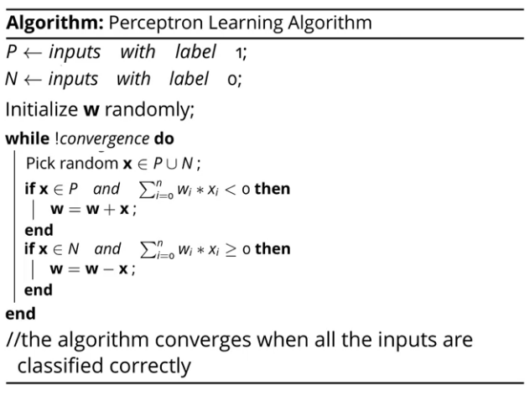

Slide 46
{01}
Fundamentals
Key-words / Concepts / Labels
Artificial neuron === Model of single biological neuron / Perceptron
Feedforward / Feed-backward / Hebbian learning
Bias / Threshold
Weights /adjustable parameters / Memory
Unit / Node / Activation Functions (Sigmoid / Step)
Input / Output / Layers / Input vs Output Space
Target / Teacher / Error / learningrate
Iterations / Epochs / Baches
Logical functions AND / OR / XOR (Boolean Algebra)

Slide 47
{01}
Fundamentals
Maths + Python Key-words / Concepts
PYTHON MODULES import Numpy as np
import Matlibplot.pyplot as plt
class
def return
for (loops)
if else
zip
print
list
append
+=
Matrix Calculus
np.zeros
np.random.normal
np.dot
Plotting
plt.subplots()
plt.subplot(221)
plt.plot(epoch, error)
plt.xlabel('Epoch')
plt.ylabel('Error')

Slide 48
{01}
Fundamentals
The PERCEPTRON
The perceptron was very promising, but it was soon discovered that is has serious limitations as it only works for linearly-separable classes.
In 1969, Marvin Minsky and Seymour Papert
demonstrated that it could not learn even a simple logical function such as XOR.
This led to a significant decline in the interest in perceptron’s
and Machine learning as a whole.

Slide 49
{01}
Fundamentals
Simple Predicting Machine
The Concept of Input / Output model

Slide 50
Boolean Logic
IF I have eaten my vegetables AND I am still hungry
THEN I can have ice cream.
IF it’s the weekend OR I am on annual leave THEN I’ll go to the park.
Input A | Input B | AND | OR
0 | 0 | 0 | 0
0 | 1 | 0 | 1
1 | 0 | 0 | 1
1 | 1 | 1 | 1

Slide 51
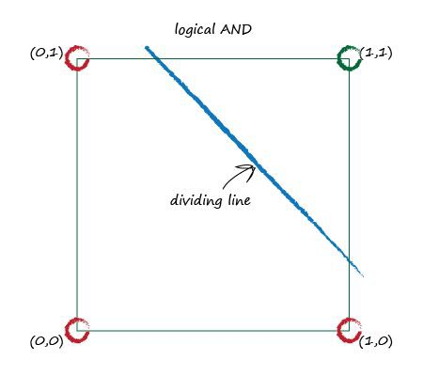
XOR Puzzle!
Input x1 | Input x2 | AND y
0 | 0 | 0
0 | 1 | 0
1 | 0 | 0
1 | 1 | 1

Slide 52
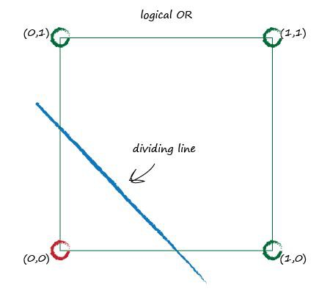
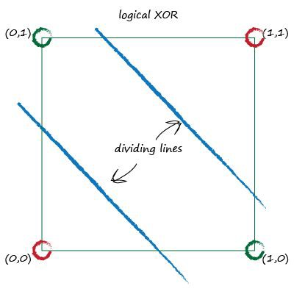
XOR Puzzle!

Slide 53
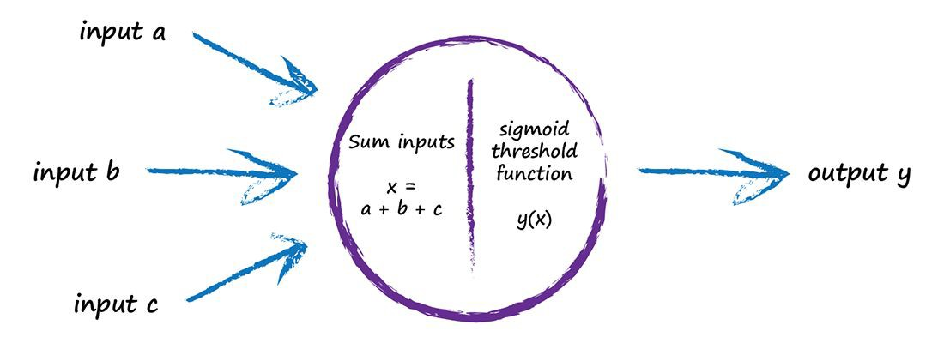
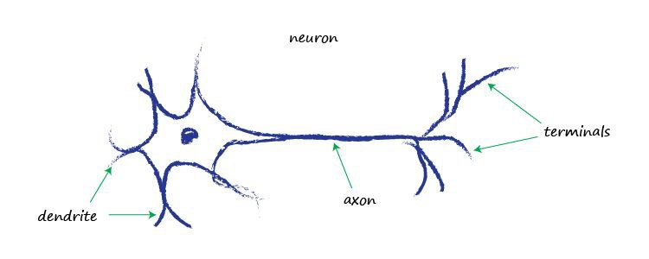
{01}
Fundamentals
Artificial Neuron
Artificial Neuron Model: input vs output

Slide 54
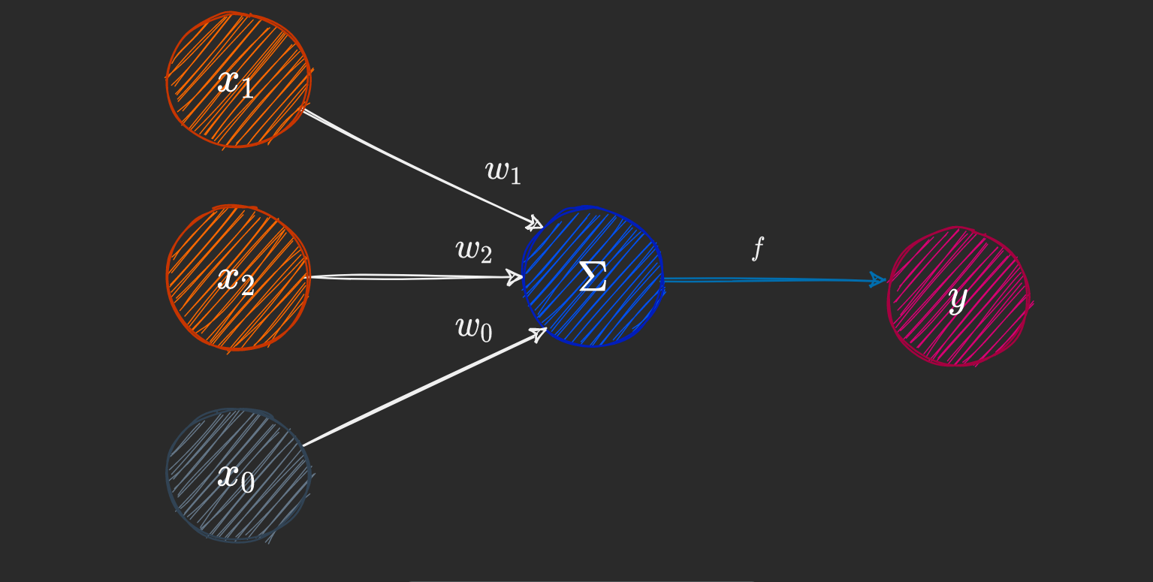
{01}
Fundamentals
Artificial Neuron
Artificial Neuron Model:
PERCEPTRON structure
Perceptron Components :
Input nodes x0 … Xn
Output node y
An activation function
Weights and biases
Summation
Activation Function f

Slide 55

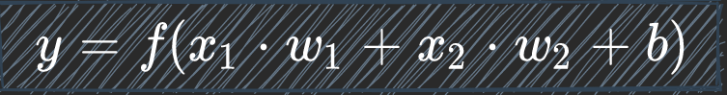
{01}
Fundamentals
Artificial Neuron
Artificial Neuron Model:
PERCEPTRON maths
FEED FORWARD CACULATION:
The output calculation is straightforward.
Compute the
DOT PRODUCT
of the input
[x1 x2]
and weight vector
[w1 w2]
The bias b equals w0
Apply the activation function.
Feedforward computation:
(DOT PRODUCT is a form of mathematical summation)

Slide 56
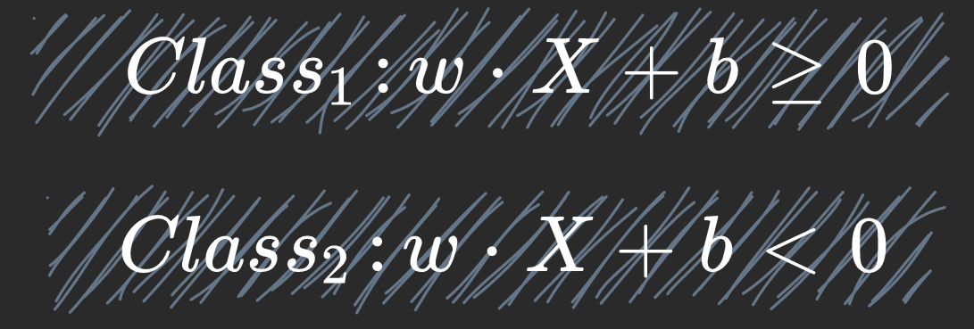
XOR Puzzle!

Slide 57
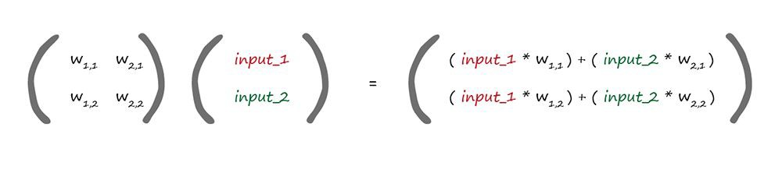
{01}
Fundamentals
Matrix Multiplication
Artificial Neuron Model:
PERCEPTRON maths
weights
incoming signals
W · I = X
dot product

Slide 58
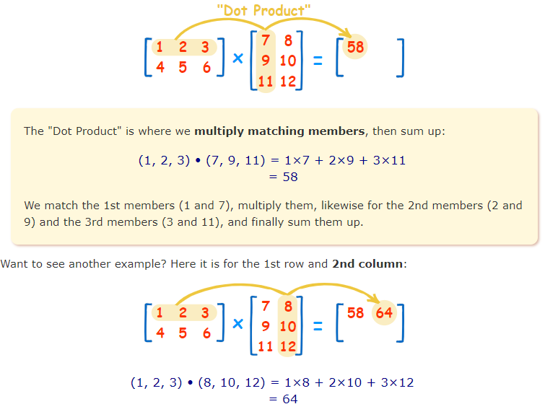
{01}
Fundamentals
XOR Puzzle!

Slide 59
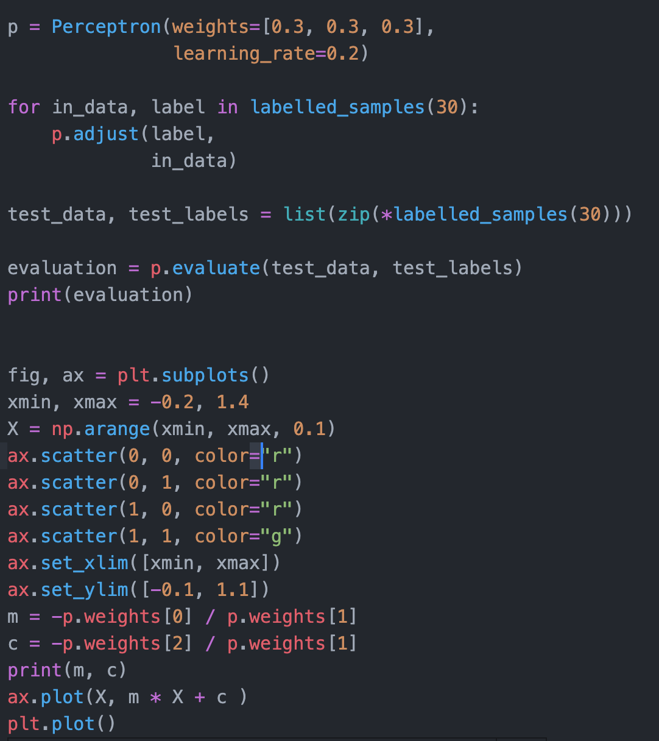
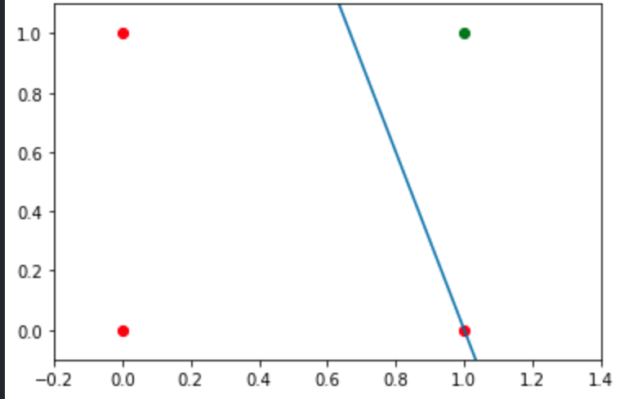
{01}
Fundamentals
XOR Puzzle!

Slide 60
XOR Puzzle!
PYTHON PERCEPTRON MODEL code
import Numpy as np
import Matlibplot.pyplot as plt
Learn how to specify: input/output relationship
Initialize weights
Forward computation

Slide 61
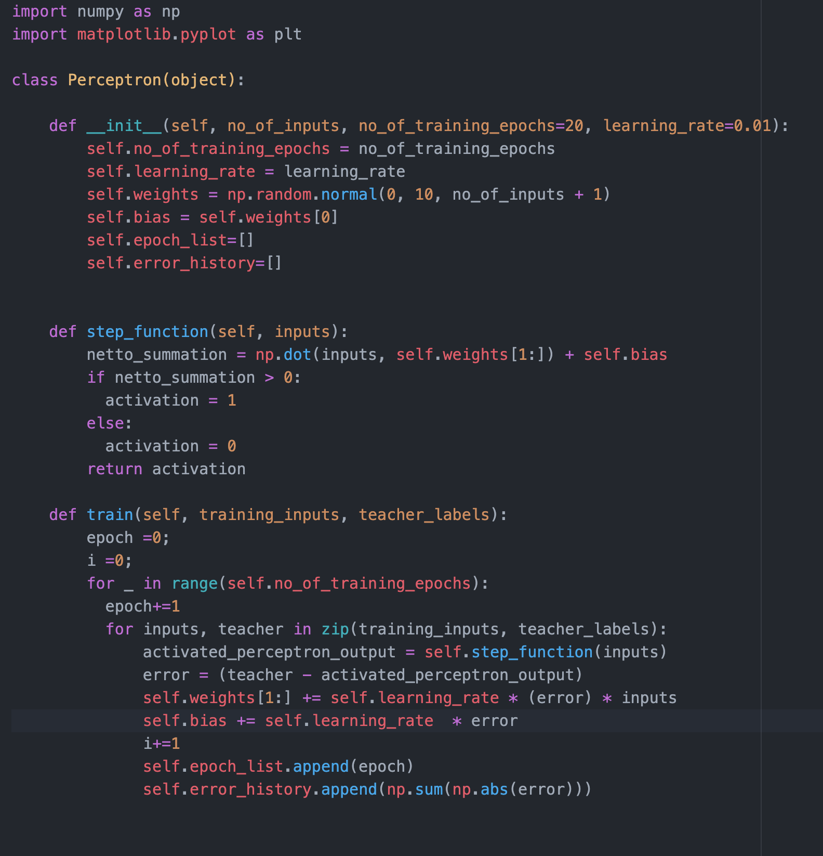
XOR Puzzle!
PYTHON PERCEPTRON MODEL code
import Numpy as np
import Matlibplot.pyplot as plt
Where are input & ouput specified?
Where are the weights initialized?
How is the Forward computation specified?
To Do:
Change the code as to print
Interation number
Bach number
Error
And weights

Slide 62
XOR Puzzle!
PYTHON
INPUT / OUTPUT relationship code
import Numpy as np
import Matlibplot.pyplot as plt
import numpy as np
inputs = []
inputs.append(np.array([1, 1]))
inputs.append(np.array([1, 0]))
inputs.append(np.array([0, 1]))
inputs.append(np.array([0, 0]))
teacher = np.array([1, 0, 0, 0])
USING ZIP
print([inputs for teacher in zip(inputs, teacher)])
print([i for i in zip(inputs, teacher)])

Slide 63
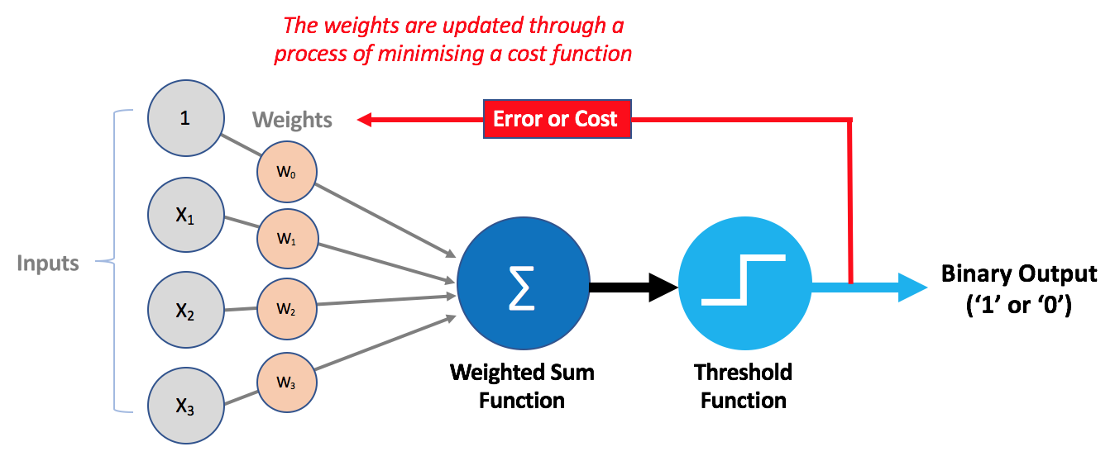
{01}
Fundamentals
XOR Puzzle!
NEXT WEEK:

Slide 64
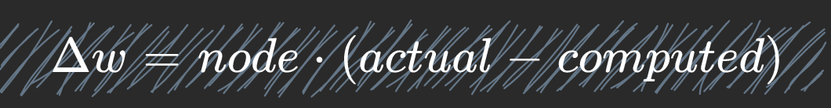
{01}
Fundamentals
XOR Puzzle!
Artificial Neuron Model:
PERCEPTRON maths
Error calculation

Slide 65
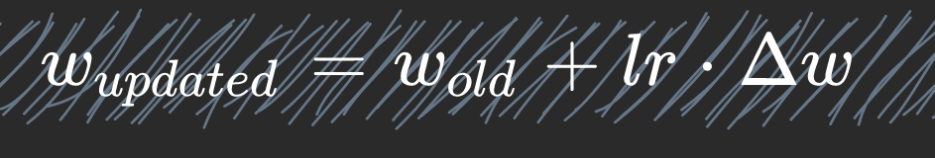
{01}
Fundamentals
XOR Puzzle!
Artificial Neuron Model:
PERCEPTRON maths
FEED BACKWARD calculation

Slide 66
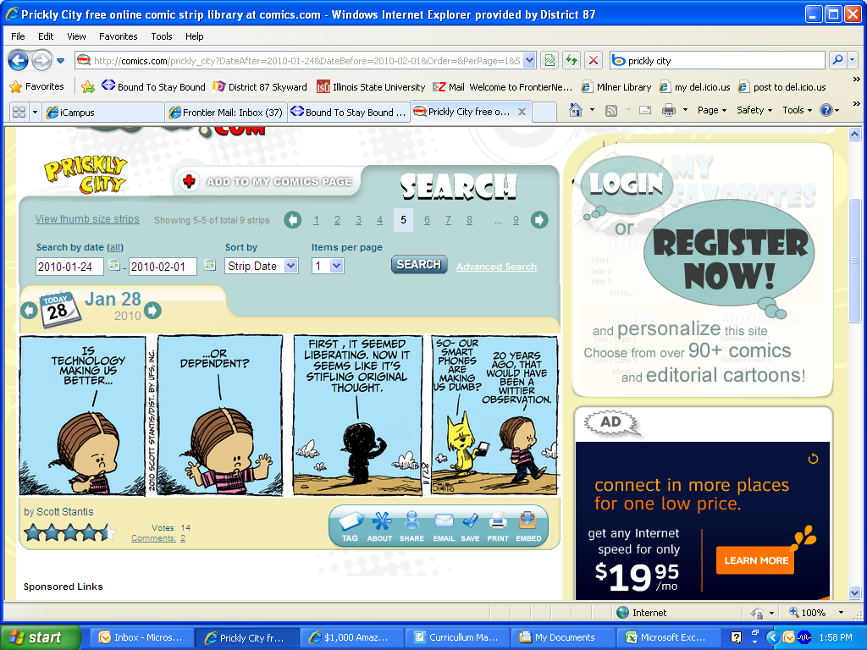

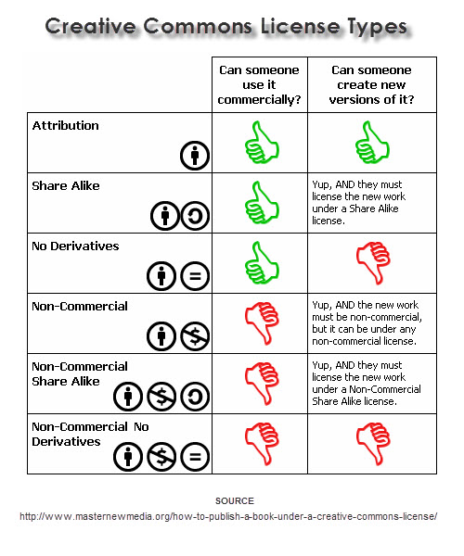
This lesson was developed by:
Robert Frans van der Willigen
CMD, Hogeschool Rotterdam
OKT 2020
http://creativecommons.org/licenses/by-nc-sa/3.0/
This lesson is licensed under a Creative Commons Attribution-Share-Alike license. You can change it, transmit it, show it to other people. Just always give credit to RFvdW.
http://empoweringthenatives.edublogs.org/2012/03/15/creative-commons-licenses/
http://creativecommons.org/licenses/

